Slide 1


DroneBlocks & Python

Slide 2
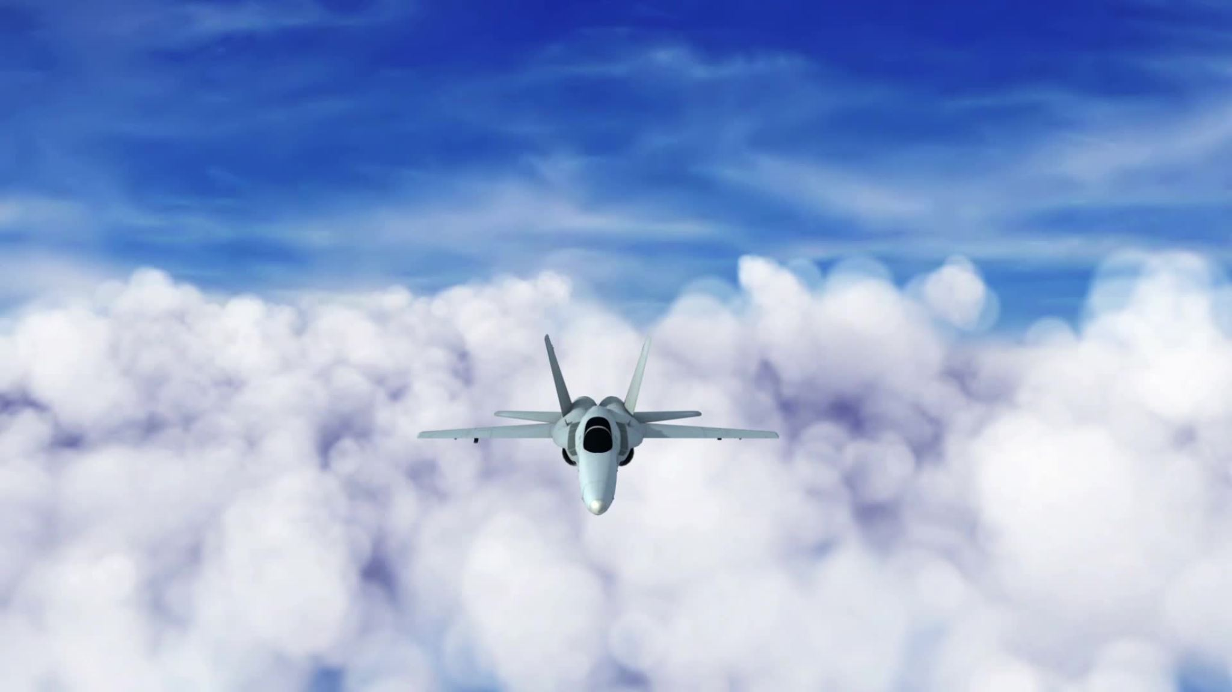
Drones: Revolutionizing Industries and the Science Behind Their Flight

Slide 3
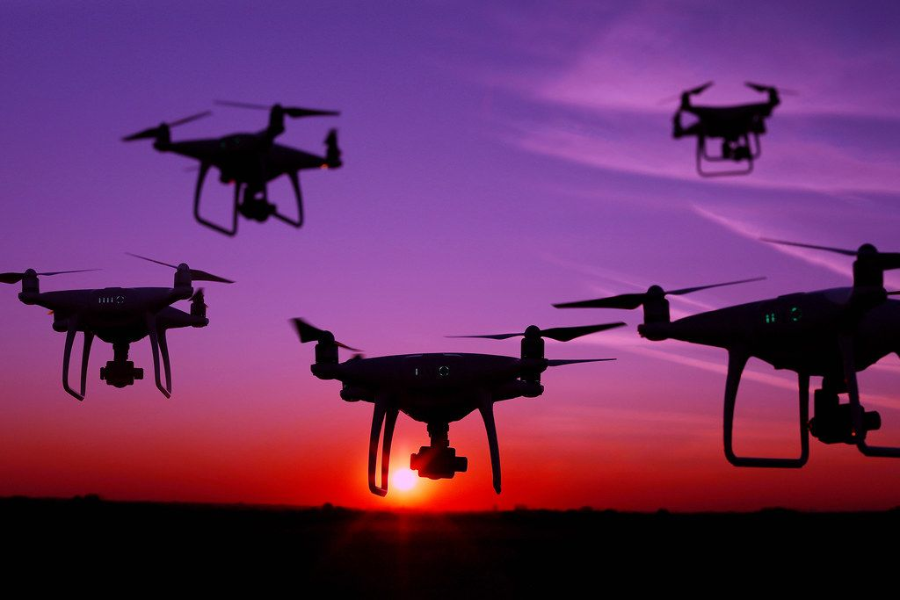
Introduction to Drones
Drones are more than just cool gadgets - they are transforming industries ranging from agriculture to construction to search and rescue.
Notes:
Drones, also known as unmanned aerial vehicles (UAVs), are rapidly becoming a ubiquitous presence in our skies. These flying machines have captured the public imagination with their ability to take stunning aerial photographs, deliver packages, and even fight fires.
In this presentation, we will explore the physics behind drones and how they work, as well as their applications in various industries. We will showcase real-world examples of how drones are being used to increase efficiency, reduce costs, and save lives. By the end of this presentation, you will have a better understanding of the potential of drone technology and its impact on our lives.

Slide 4
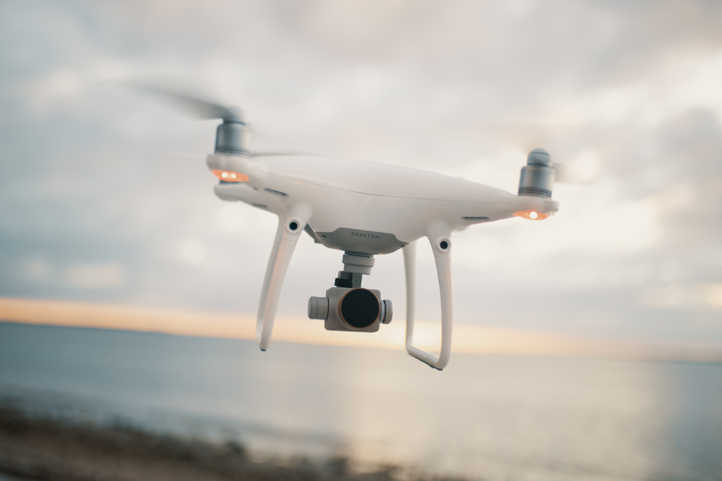
The Physics of Drones
At their core, drones rely on four basic physical concepts: lift, thrust, drag, and weight.
.
Notes:
Lift is created by the drone's propellers, which spin rapidly to generate an upward force that allows the drone to stay in the air. Thrust is generated by the motors, which power the propellers and move the drone forward. Drag is the resistance that the drone encounters as it moves through the air, and weight is the force of gravity that pulls the drone down towards the ground

Slide 5
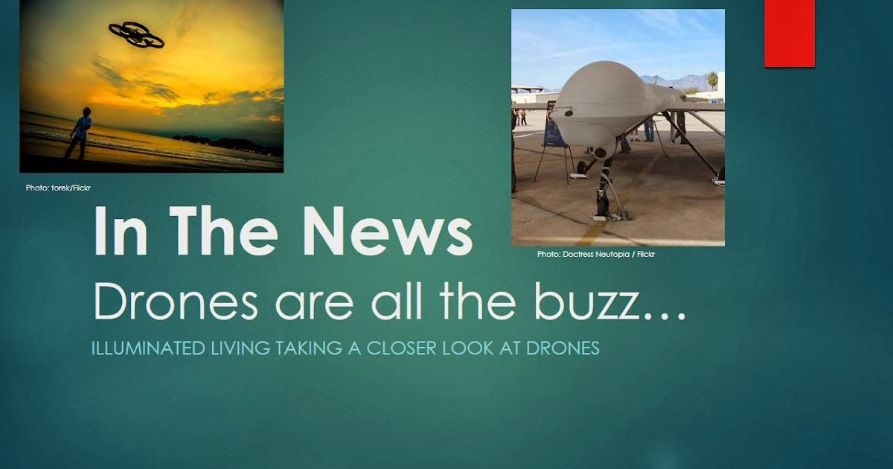

Slide 6
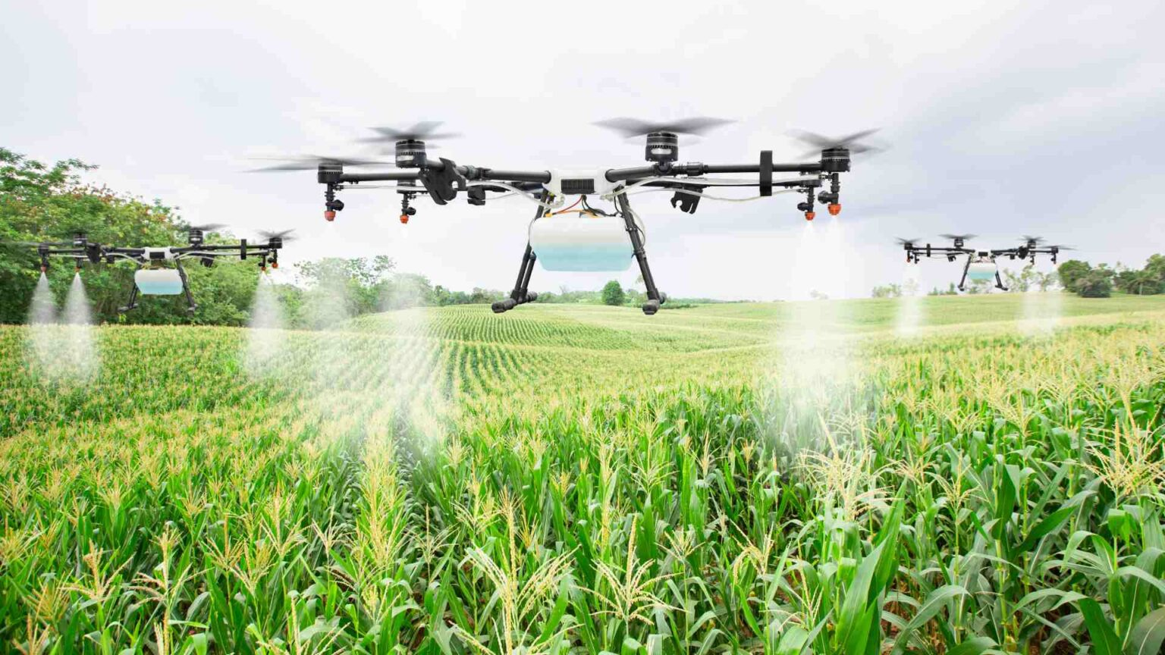
Drones in Agriculture
Crop monitoring is one of the most significant applications of drone technology in agriculture.
Yield analysis is another area where drones are proving to be invaluable. By collecting data on plant height, density, and growth rate, farmers can accurately predict yields and make informed decisions about harvest timing and storage needs.
Pesticide application is yet another area where drones are making a significant impact.
Notes:
Drones are revolutionizing the way farmers approach crop management. With their ability to capture high-resolution imagery and collect data on plant health, drones are becoming an essential tool for precision agriculture.
By flying over fields and capturing images, drones can quickly identify areas of stress or damage caused by pests, disease, or weather conditions. This information allows farmers to take action before a problem becomes widespread and results in crop loss.
By spraying crops from above, drones can apply pesticides more precisely and efficiently than traditional methods. This not only reduces waste but also minimizes exposure to harmful chemicals for both farmers and the environment.

Slide 7
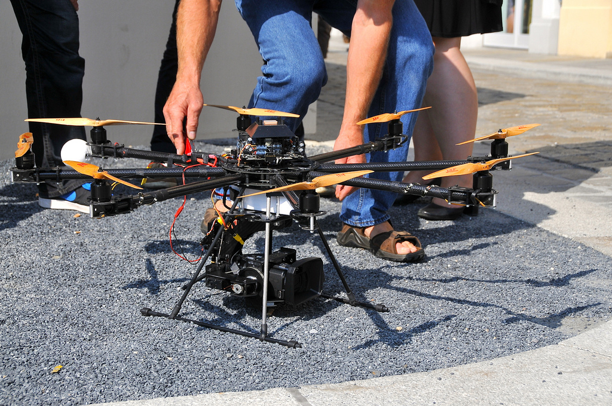
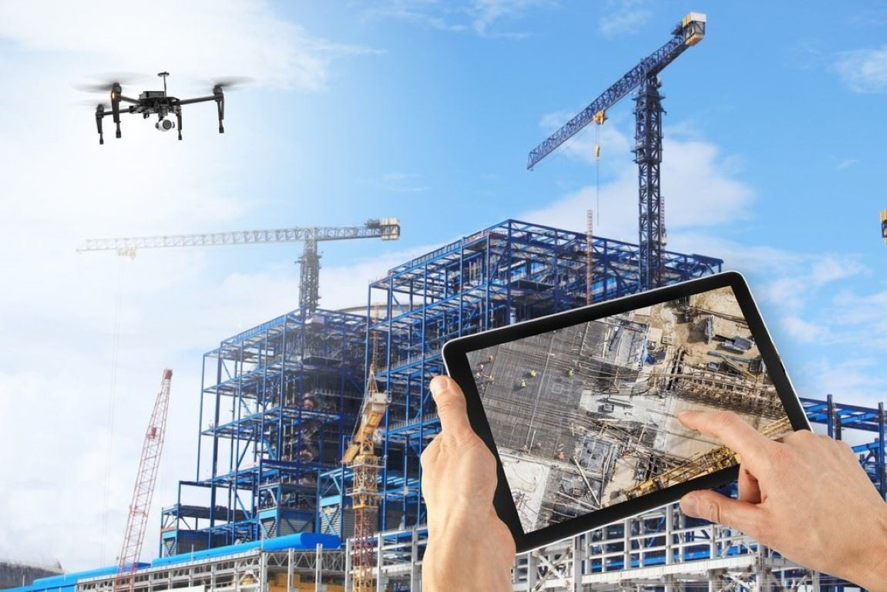
Drones in Construction
Drones have become an increasingly popular tool in the construction industry due to their ability to provide accurate and efficient data on construction sites.
In addition to site inspections, drones can also be used for mapping and progress monitoring.
Notes:
Site inspections can be conducted quickly and safely using drones, which can capture high-resolution images and videos of the entire site.
By using drones equipped with advanced sensors, construction companies can create detailed maps of construction sites and track progress over time. This allows for more efficient project management, as well as greater accuracy in budgeting and scheduling.

Slide 8
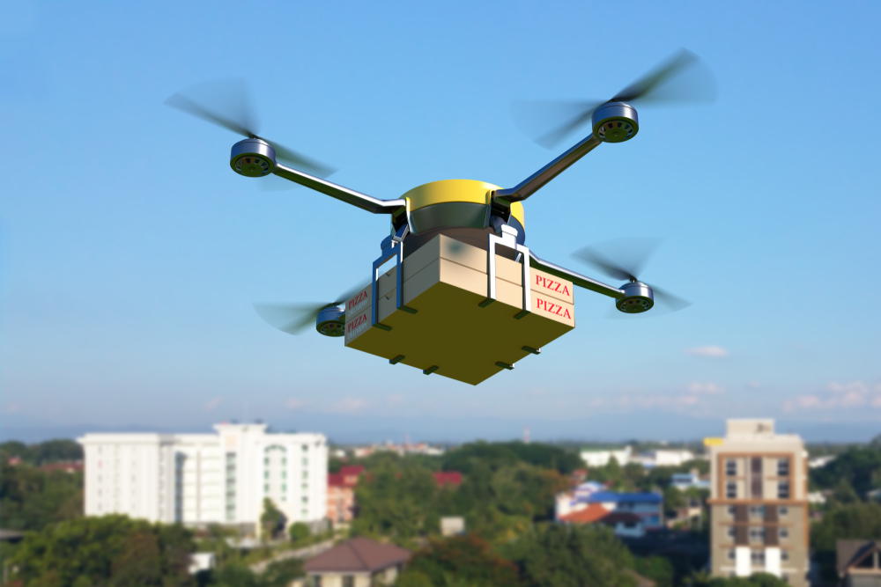
Drones in Day-to-Day Life
This Photo by Unknown author is licensed under CC BY-SA-NC.
Companies such as Amazon and UPS have already started testing drone delivery services, which can greatly reduce delivery times and costs.
This Photo by Unknown author is licensed under CC BY-SA-NC.
Notes:
Drones can also be used for inspecting infrastructure such as power lines, bridges, and pipelines, which can be dangerous for human inspectors. Moreover, they can be used for search and rescue operations, monitoring wildlife, and even capturing stunning aerial footage for films and documentaries.
Ans are now being used across the world during various celebration to reduce the environmental impact of fireworks

Slide 9
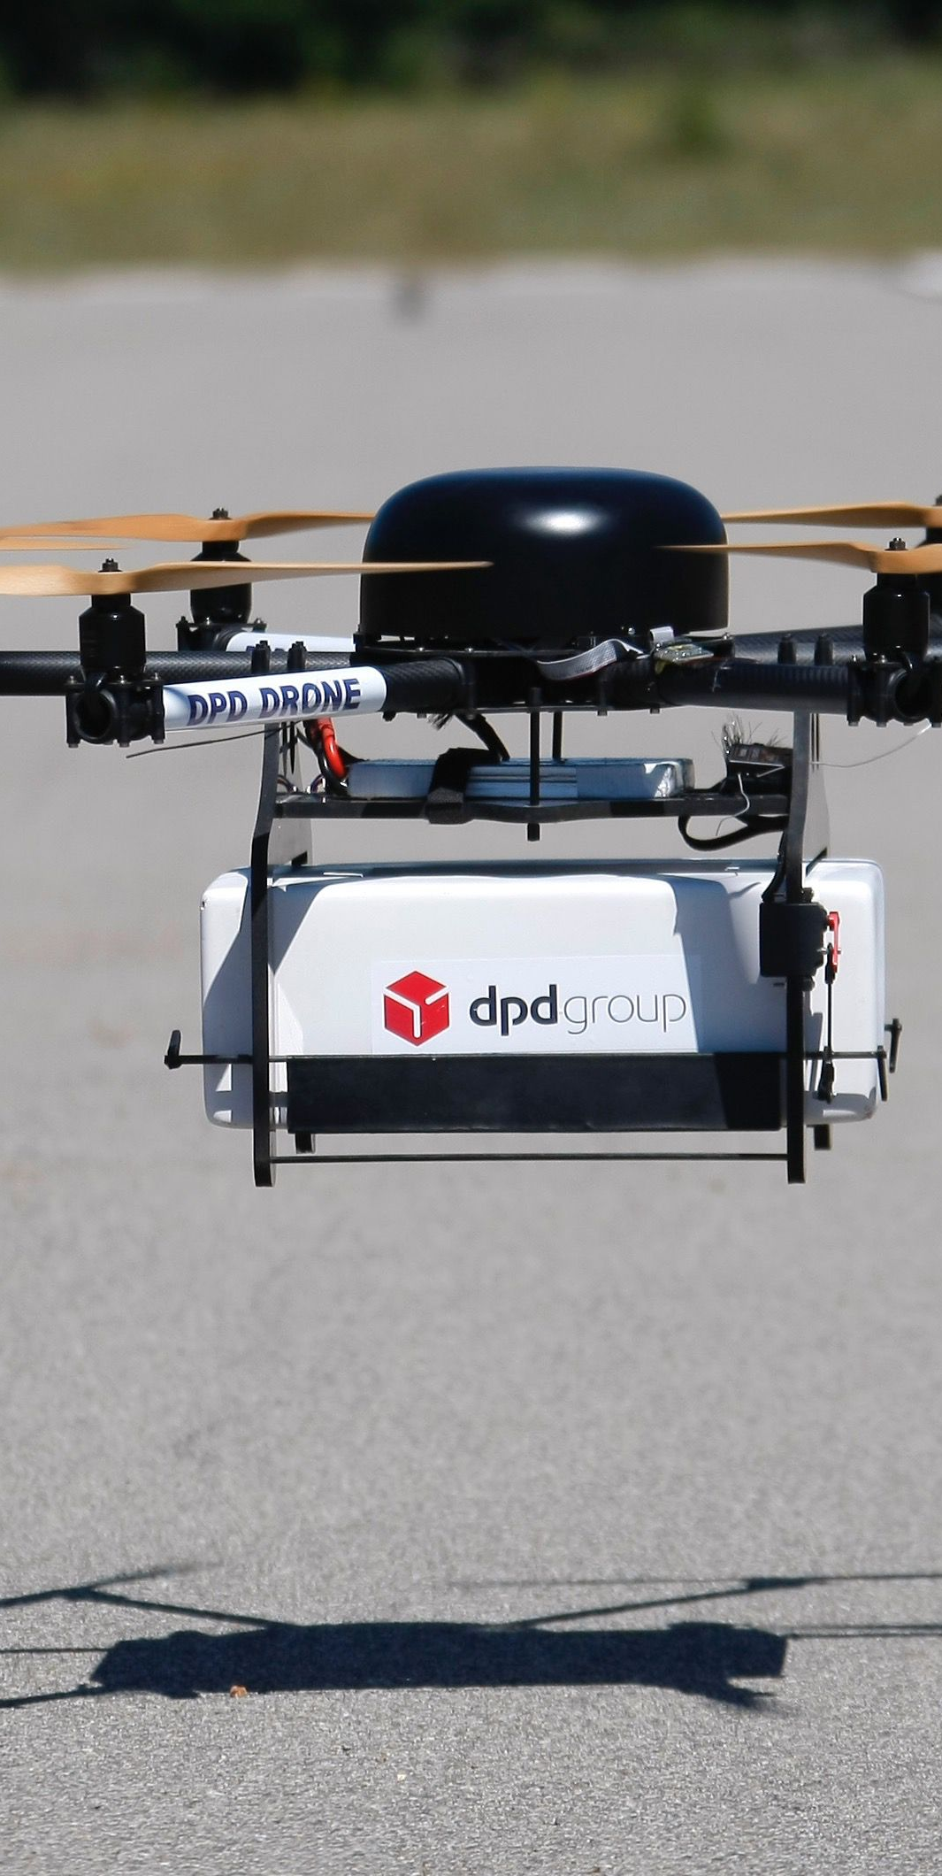
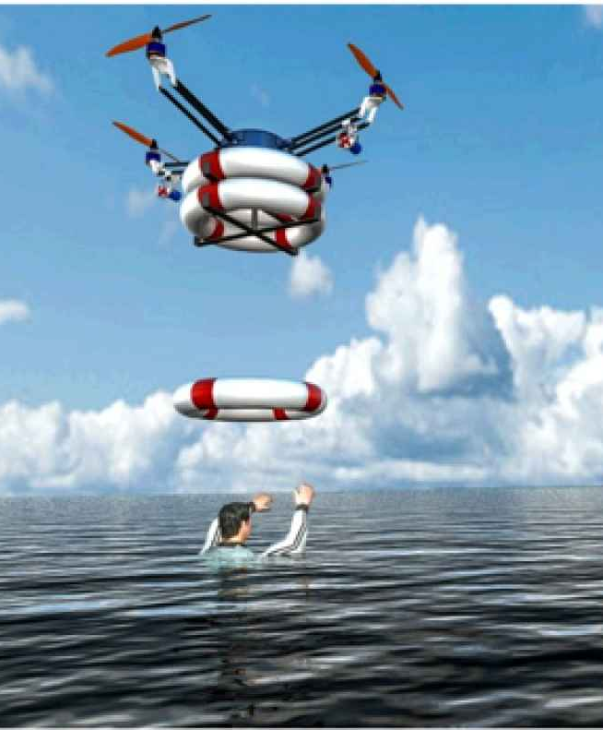
Drones in Search and Rescue
With their ability to fly at great heights and cover large distances in a short amount of time, drones are becoming an increasingly important tool for search and rescue teams around the world.
Notes:
Search and rescue operations can be incredibly challenging, particularly when trying to locate individuals in hard-to-reach locations or covering large areas quickly. This is where drones can make a real difference.
One of the key advantages of using drones in search and rescue operations is their ability to access hard-to-reach locations. Whether it's a mountainous region or a dense forest, drones can quickly fly to areas that would otherwise be impossible to reach by foot or vehicle. Additionally, drones equipped with cameras and other sensors can provide valuable information to rescue teams, such as thermal imaging to detect body heat or high-resolution imagery to identify potential hazards.

Slide 10
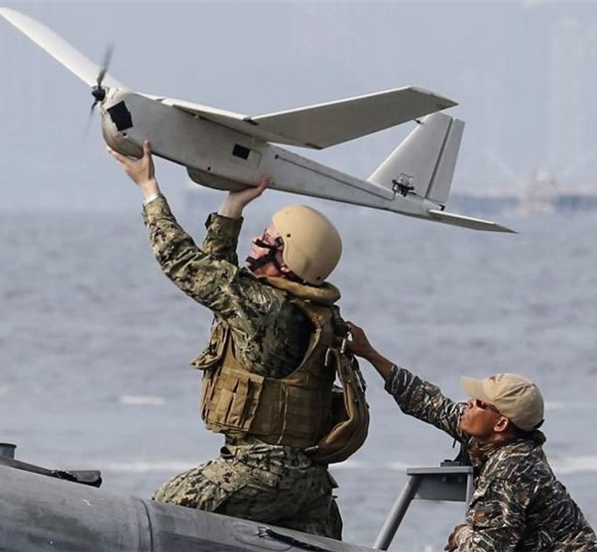
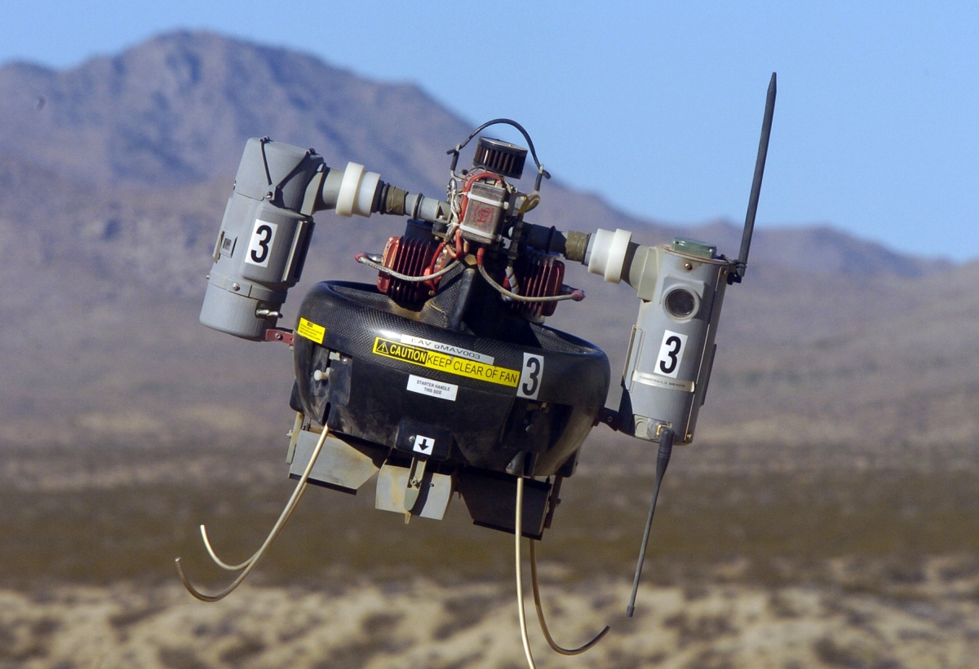
Drones in Military
Drones have become an integral part of modern warfare, allowing military forces to gather intelligence and conduct operations with greater precision and efficiency.
Drones can also be equipped with weapons, making them a powerful tool on the battlefield.
Notes:
With their ability to fly at high altitudes and cover large areas quickly, drones are particularly useful for reconnaissance missions, providing real-time video feeds and other data to commanders on the ground.
Armed drones have been used to target enemy positions and take out high-value targets, reducing the risk to human soldiers. However, the use of armed drones has also raised ethical concerns, particularly when it comes to civilian casualties and the potential for abuse.

Slide 11
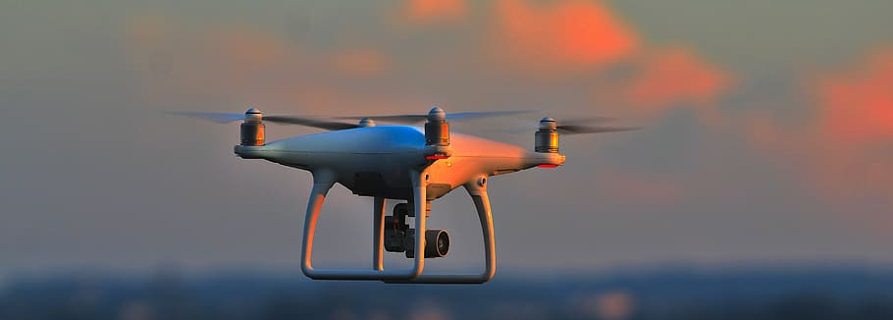
Conclusion
The increasing use of drones also poses challenges and concerns. Privacy issues arise as drones can potentially invade people's personal spaces and capture sensitive information. There are also safety concerns as drones can collide with other aircraft or crash into buildings and people. As such, regulations and guidelines must be established to ensure responsible and safe drone usage.
In conclusion, drones are revolutionizing various industries by providing efficient and cost-effective solutions. From agriculture to construction and search and rescue operations, drones are making a significant impact.
The principles of physics that make drones possible are fascinating, and the potential for innovation and advancement is endless. As we continue to explore the capabilities of drone technology, we can only imagine the possibilities it holds for the future.

